Slide 1
Bacterial gene and genome annotation
13/06/2024
Dr. Luu Phuc Loi (luu.p.loi@googlemail.com)

Slide 2
Content
Bacterial genomes
Bacterial Genes
Genome Annotation
Prokka
Curating genomes
Bakta

Slide 3
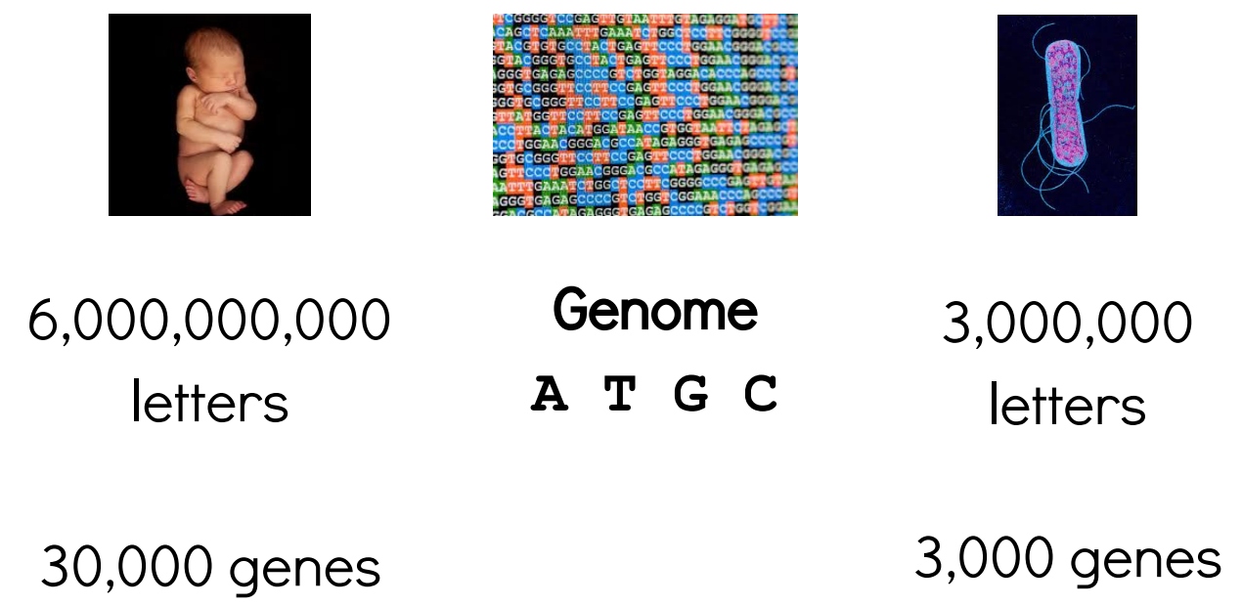
Bacterial genomes: small genomes
https://angus.readthedocs.io/en/2016/_static/bacterial_genome_annotation.pdf

Slide 4
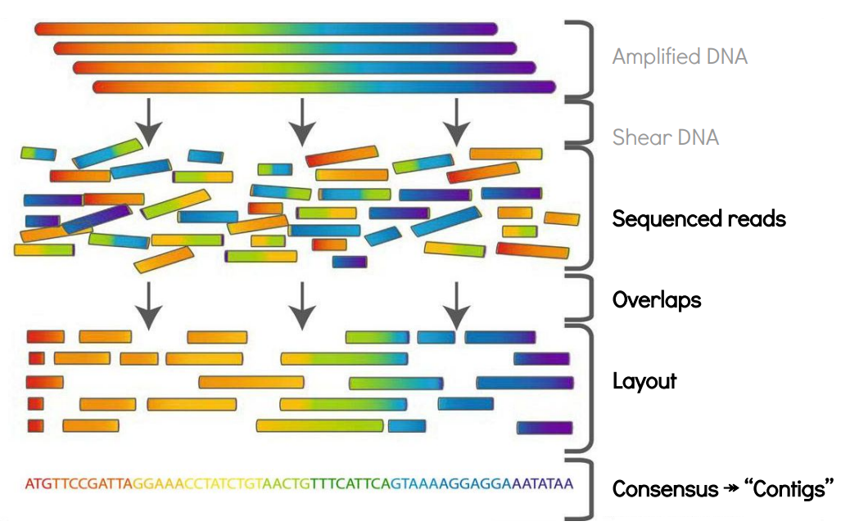
De novo assembly

Slide 5
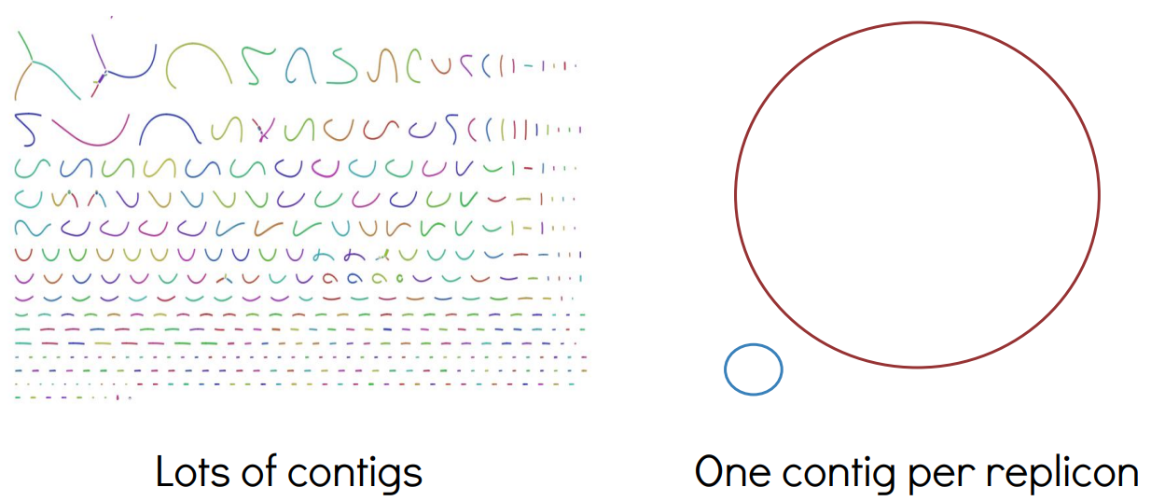
Draft vs Finished genomes

Slide 6
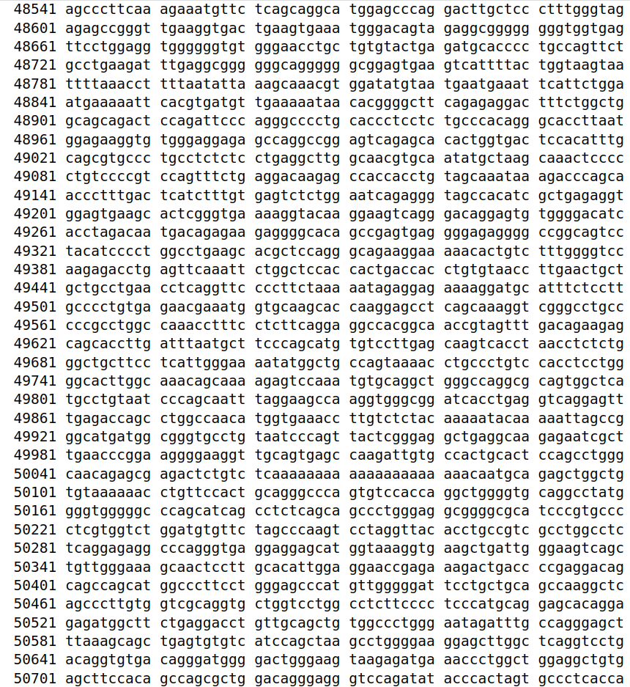
https://www.ncbi.nlm.nih.gov/nuccore/806904736

Slide 7
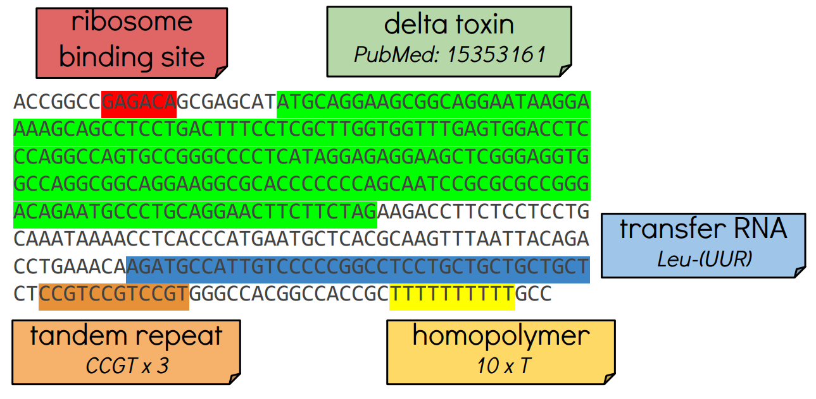
Genome Annotation: Adding biological info to sequences

Slide 8
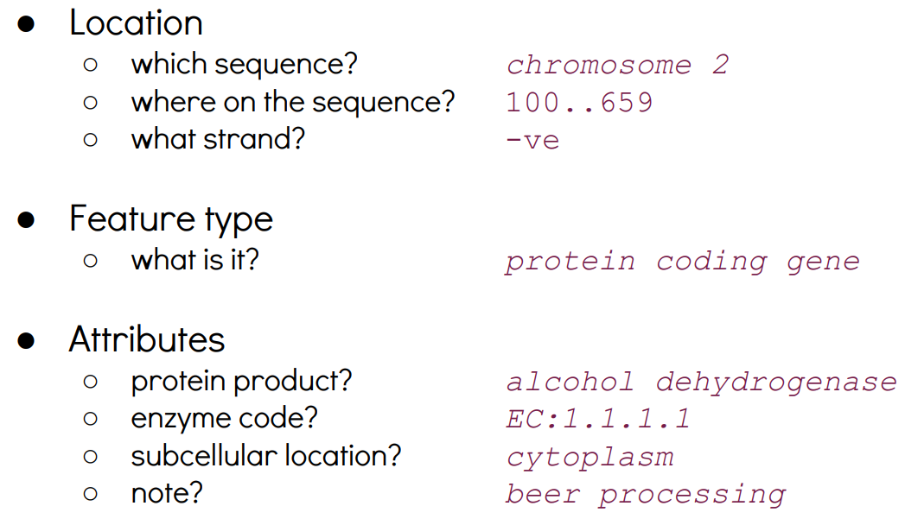
What's in an annotation?

Slide 9
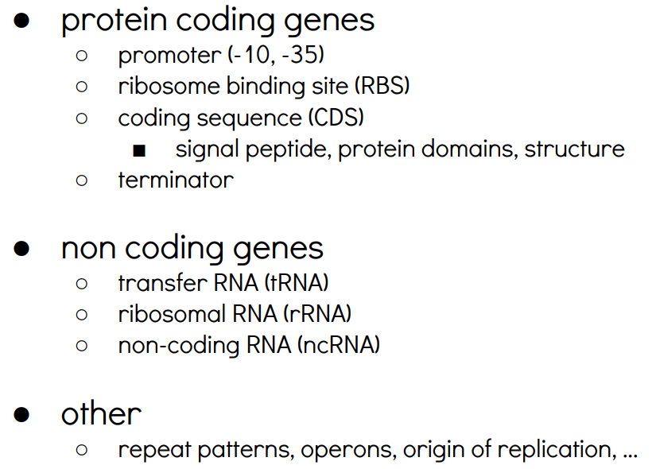
Bacterial feature types

Slide 10
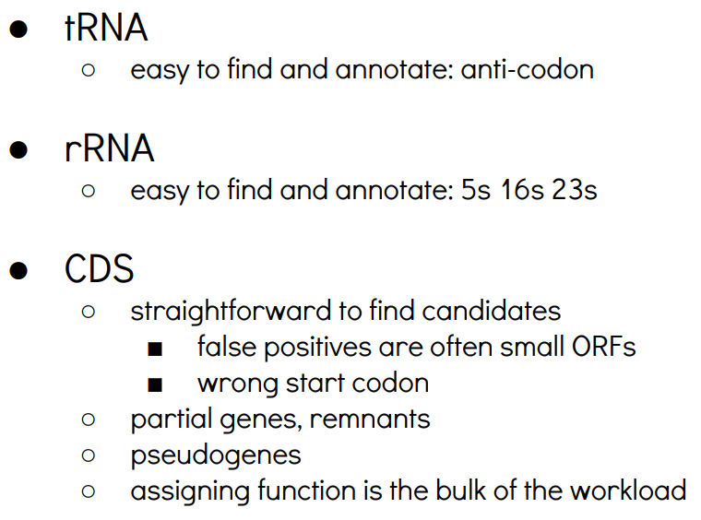
Key bacterial features

Slide 11
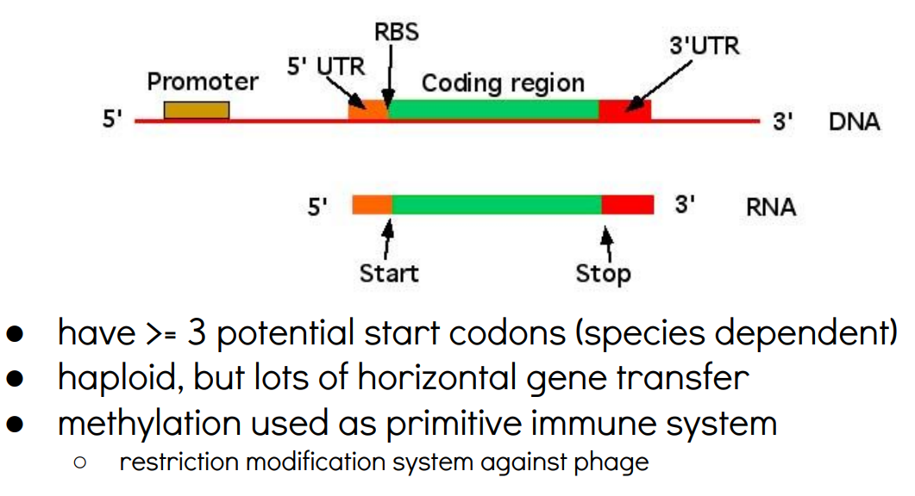
Bacterial genes: no introns!

Slide 12
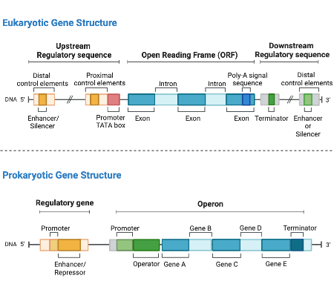
Prokaryotic vs eukaryotic Genes
https://study.com/skill/practice/contrasting-the-regulation-of-gene-expression-in-prokaryotic-eukaryotic-organisms-questions.html

Slide 13
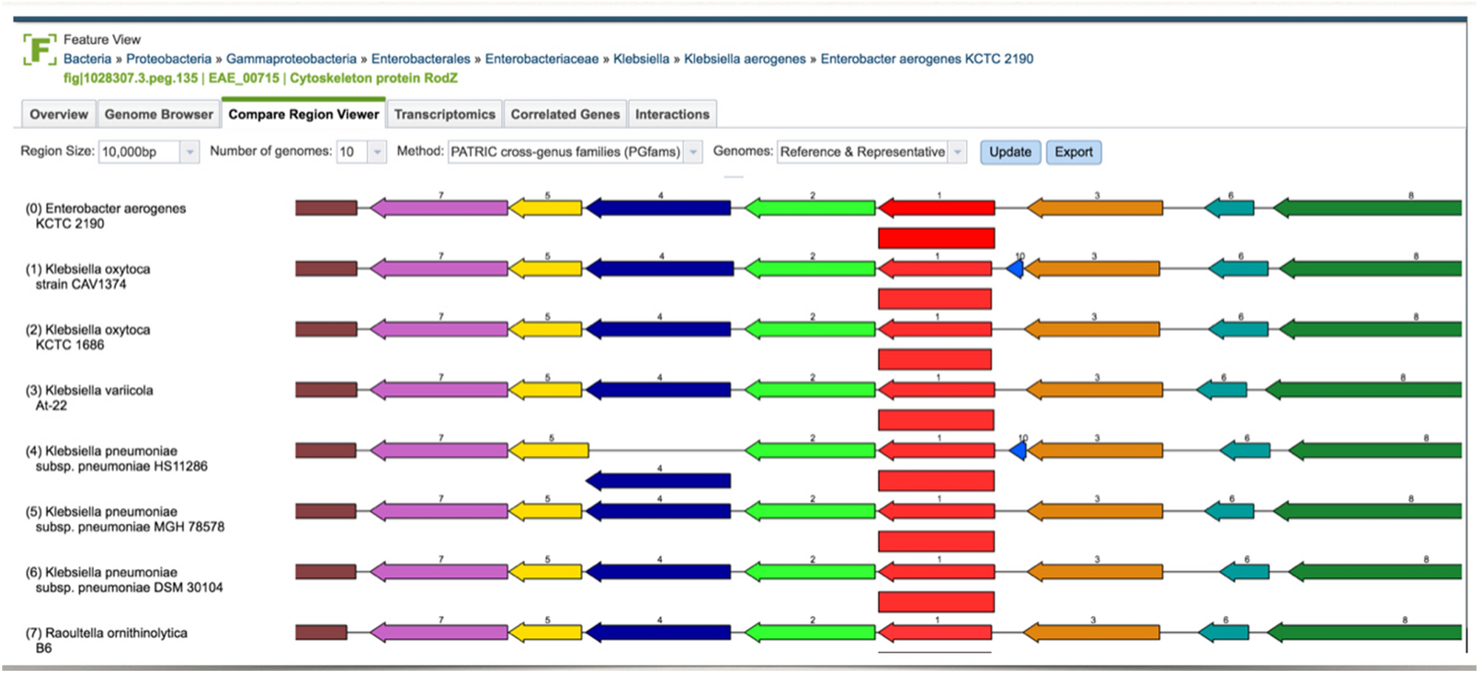
Detecting operons in bacterial genomes via visual representation learning
Snapshot of the Compare Region Viewer service provided by PATRIC (https://www.patricbrc.org). The image shows a genomic region of the query genome (first row) aligned against a set of other genomes, anchored at the focus gene (represented as a red arrow). The service starts with finding other genes that are of the same family as the focus gene, and then aligns their flanking regions accordingly.
https://www.nature.com/articles/s41598-021-81169-9

Slide 14
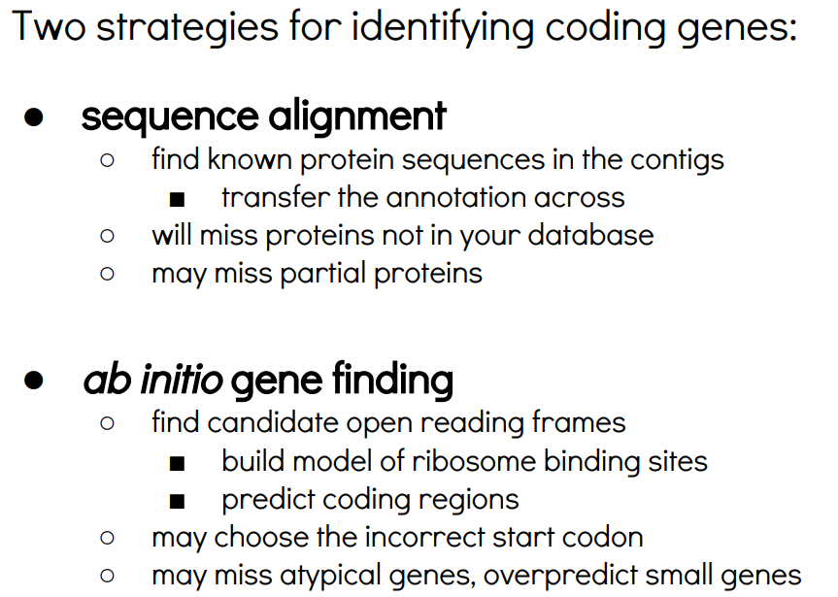
Automatic Genome Annotation

Slide 15
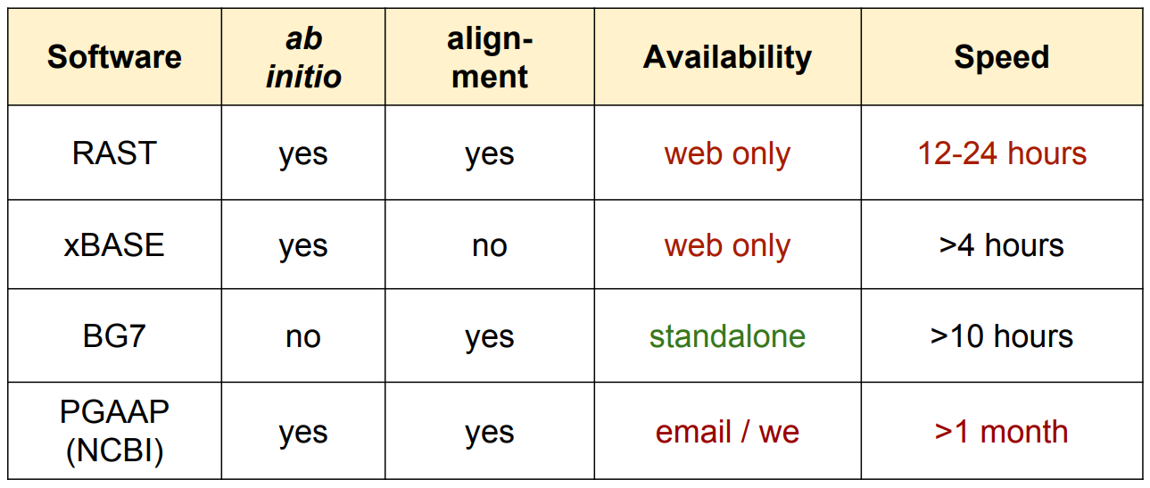
Some good existing tools

Slide 16
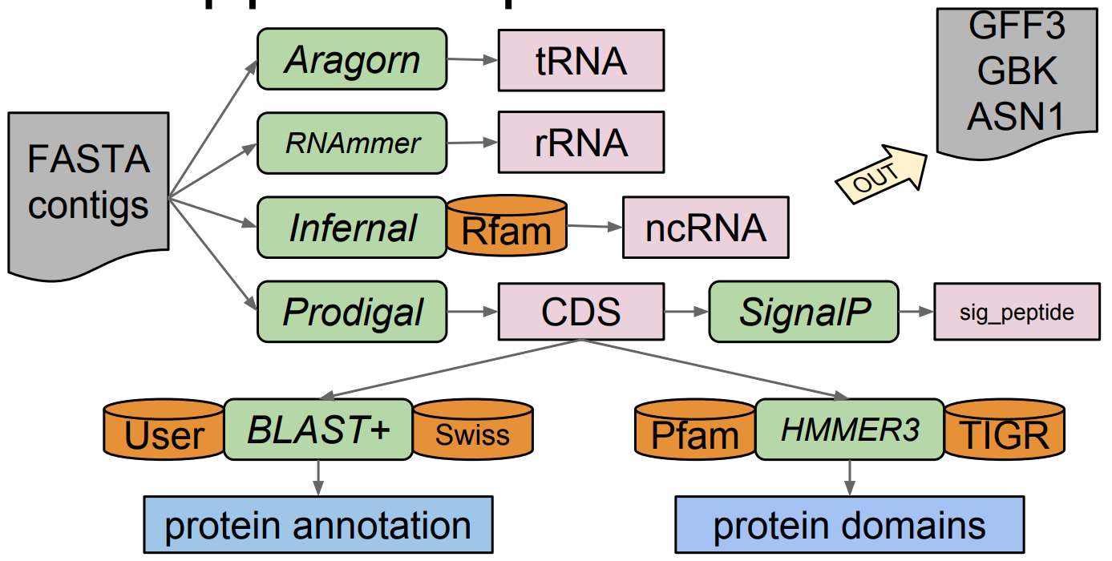
Prokka pipeline (simplified)

Slide 17
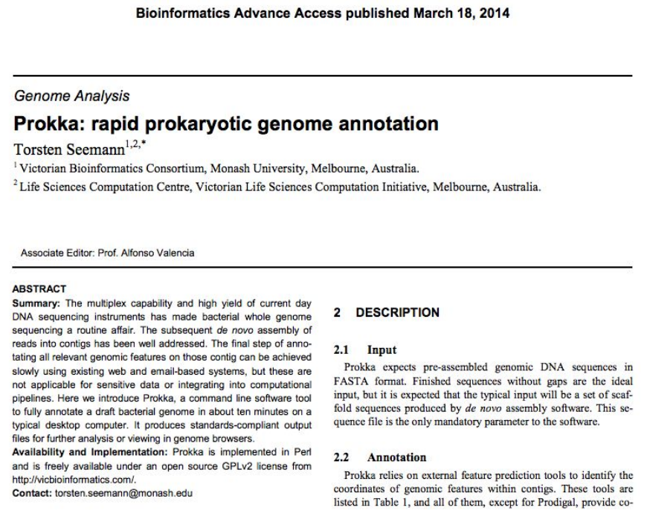
Prokka pipeline (simplified)

Slide 18
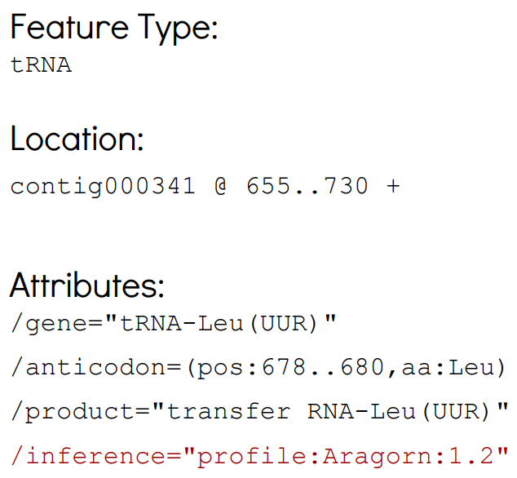
Example from Prokka

Slide 19
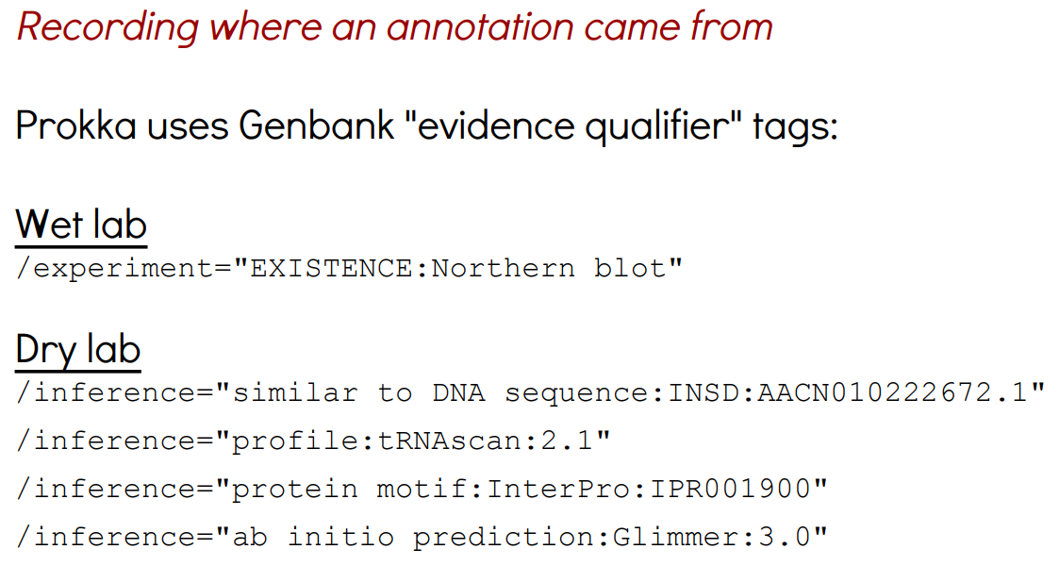
Provenance

Slide 20
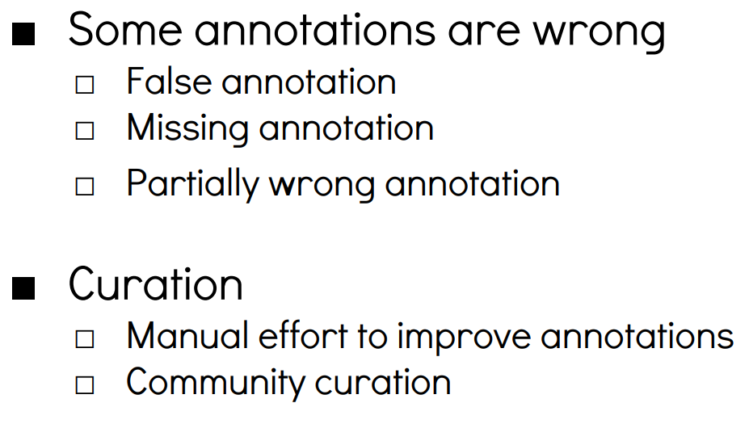
Curating genomes: Improving annotations

Slide 21
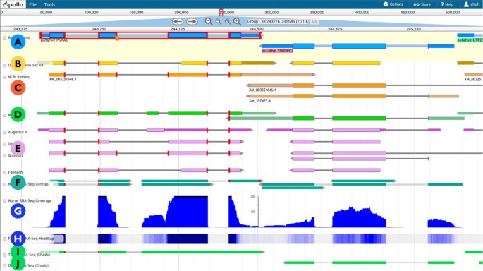
Web Apollo: a web-based genomic annotation editing platform
https://genomebiology.biomedcentral.com/articles/10.1186/gb-2013-14-8-r93

Slide 22
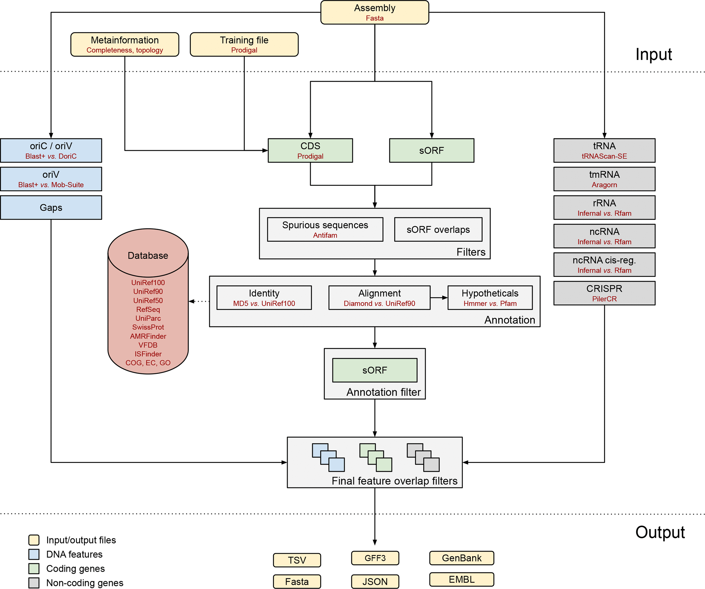
Bakta is a tool for the rapid & standardized annotation of bacterial genomes and plasmids from both isolates and metagenome-assembled genomes (MAGs)
Overview of the Bakta annotation workflow (Schwengers et al. 2021)

Slide 23
Further structural annotation
PlasmidFinder (Carattoli and Hasman 2020), a tool for the identification and typing of plasmid sequences in Whole-Genome Sequencing.
IntegronFinder (Néron et al. 2022), a tool for detecting integrons
An integron is minimally composed of:
a gene encoding for a site-specific recombinase (intI)
a proximal recombination site (attI), which is recognized by the integrase and at which gene cassettes may be inserted
a promoter (Pc) which directs transcription of cassette-encoded genes
IS (Insertion Sequence) elements: a short DNA sequence that acts as a simple transposable element
ISEScan (Xie and Tang 2017) for detection of IS

Slide 24
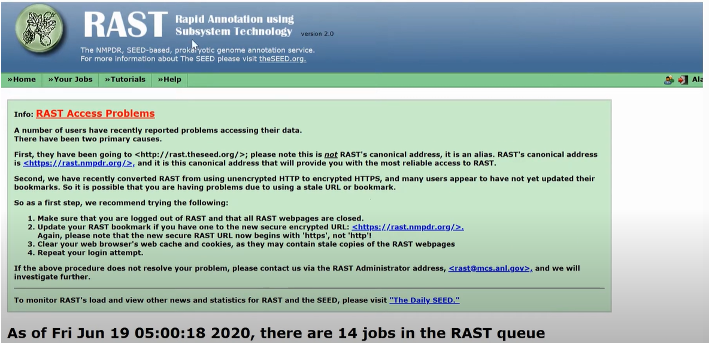
Exercise 1: Using RAST to annotate bacterial genome sequence as following
https://www.youtube.com/watch?v=pICJ4Gmqq1U

Slide 25
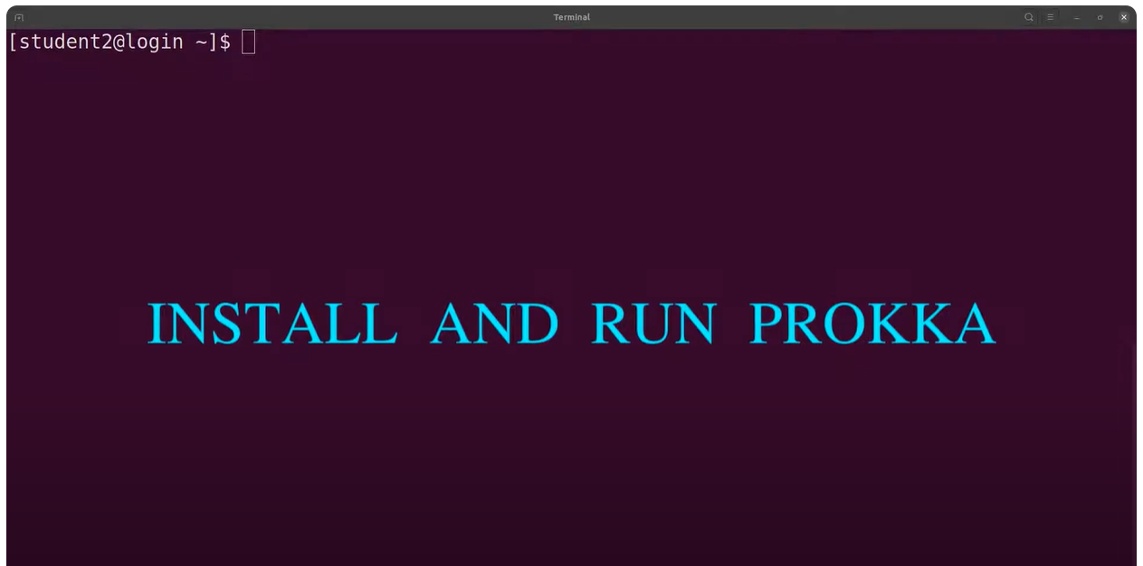
Exercise 2: Using PROKKA to annotate bacterial genome sequence as following
https://www.youtube.com/watch?v=NYbYxGf-8NM&list=PLe1-kjuYBZ04YmORKfXBCOqGDDYJtudVA&index=8

Slide 26
Thank you for your attention!

